Slide 1

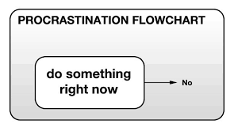
Motivation and Procrastination
Team Wicklow
Karl Turner
Conor Murphy
Andrew Owens
Daniel Tilley

Slide 2

Introduction
What are they?
What are the causes?
Solutions to them

Slide 3
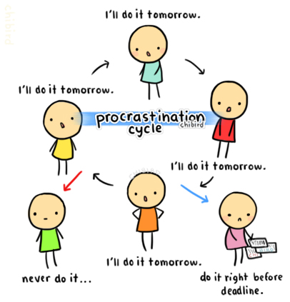
What is Procrastination?
Putting things off until last minute
Doing less important things first
Misconception of tasks

Slide 4
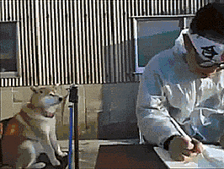
What is Motivation?
Motive + action = motivation
Different types of motivation
Ways to get motivated

Slide 5
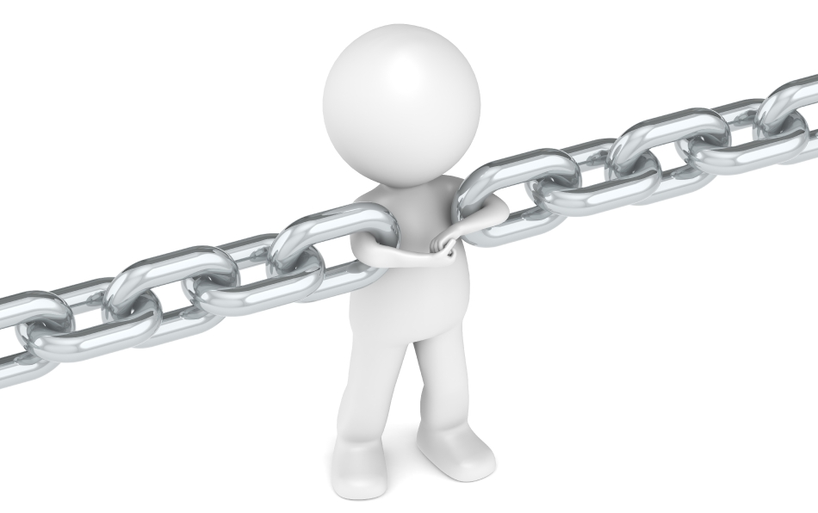
How are they linked?
Lack of one can cause another
Similarity by definition
Inversely proportional

Slide 6

Procrastination

Slide 7
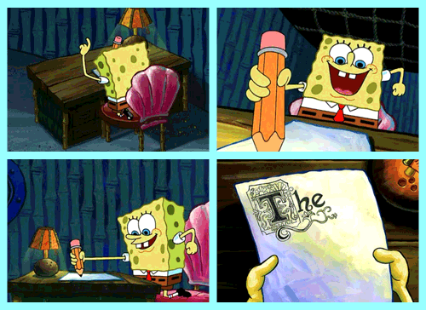
Causes
Fear of failure
Bad habits
Perfectionism
Lack of focus

Slide 8
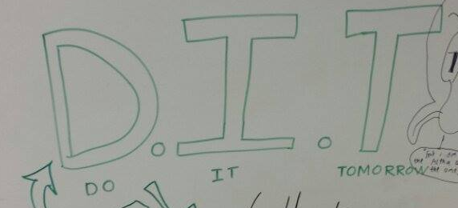
False Belief Examples
I’ll do it tomorrow
I have plenty of time
I work better under pressure
I have to be in the right mood

Slide 9
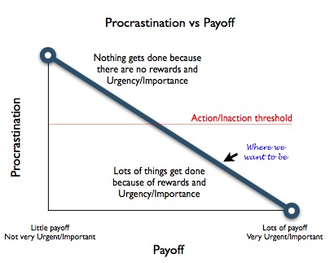
Impulsiveness
We want stuff now
Distant reward→ Valued little
Immediate reward→ Valued greatly

Slide 10

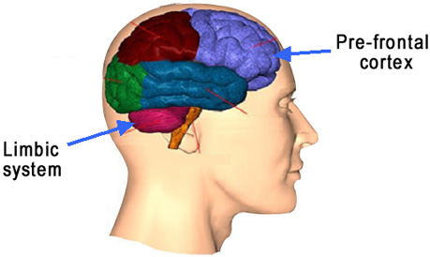
Internal War
Two areas of brain:
Prefrontal Cortex
The Limbic System

Slide 11
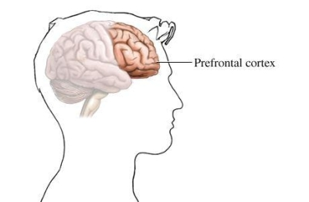
Prefrontal Cortex
Abstract thoughts
Analytical thoughts
Long-range thinking
Executive function

Slide 12
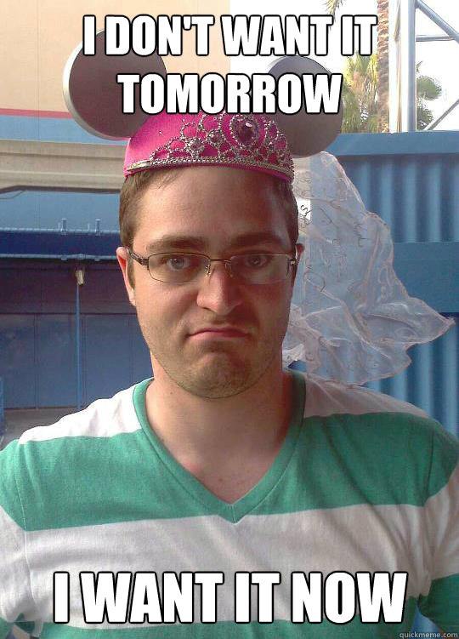
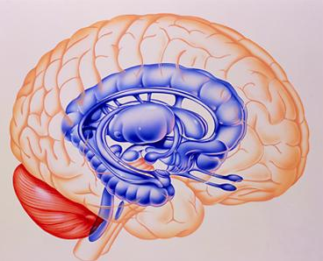
The Limbic System
Deals with emotions and memories
Responds to immediate rewards
Stimuli

Slide 13

Solutions
Can’t stop completely
Exercise good judgement
Create a plan
Self-assessment

Slide 14

Motivation

Slide 15

Why do we require Motivation?
To get started
To help us with harder tasks
To keep up

Slide 16

Intrinsic Motivation
Self-desire to do new things
To analyse ones abilities
To observe and gain knowledge
Pros and cons?

Slide 17

Extrinsic Motivation
Influences outside the individual
Rewards and punishment
Pros and cons?

Slide 18
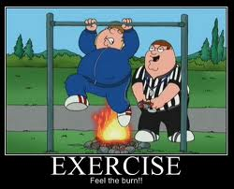
Intrinsic vs Extrinsic
Extrinsic motivation can decrease desire
Extrinsic does not need intrinsic
Intrinsic may require extrinsic
Example of school kids

Slide 19
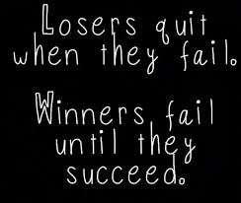


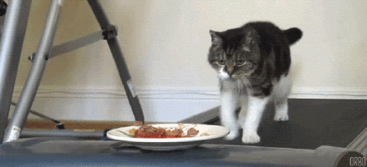
How to get motivated
Do what is best for you
Game time with Daniel

Slide 20
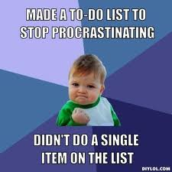
Motivation + Procrastination

Slide 21

Correlation and Causality
What are correlation and causality?
Motivation and procrastination correlation and causality

Slide 22

Motivation and Procrastination Relations
Are they related?
How are they related?

Slide 23

Questionnaire
Study in Korea of 262 students
Motivation, procrastination and flow
What is flow?
What were the results?

Slide 24

Conclusion
Better understanding
Causes and how to deal with them
Help with your study

Slide 25

Any Questions?

